Slide 1
Java Workshop 5 - Functions
Functions really increase the functionality of your program
Ben Schwarz

Slide 2
Lesson Outline
What is a Function/Method and how to make:
Parameters in java
Pass-by-value vs Pass-by-reference
Overloading
Var args
Documentation
Single Line
Multi-line
Java Doc

Slide 3


Functions – What and Why?
We’ve been using functions and methods for some time now. In each instance, they’ve allowed us to do something that you’d logically expect a lot of people want to do, such as getting the size of an ArrayList in the last workshop. Functions
Perform a task/operation
Can return a result
Can take inputs that determine their operation
Are called on classes, rather than objects
Functions are especially useful in removing the need for duplicated code. We can put the code in a function, and just call the function.

Slide 4
Two parts to methods/functions
Function Declaration
Function Call

Slide 5
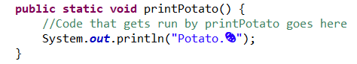
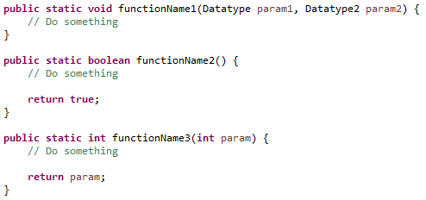
Method Declaration
There are two parts to a method declaration:
Header
Modifiers
Type
Name
Parameters
Body

Slide 6

Syntax Overview – Functions
Definition:
Header: public static¹ returnType functionName(parameter definition)
Parameter definition: Datatype1 paramName1, ...
Calling:
functionName(parameter list)
The parameter list doesn’t have their datatypes
“ClassName.” is used to access functions in other classes
¹ We’ll look at “public static” when we do OOP.

Slide 7
Syntax Overview – Functions
Calling:
functionName(parameter list)
The parameter list doesn’t have their datatypes
“ClassName.” is used to access functions in other classes

Slide 8
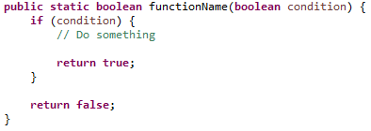

Return
Return immediately ends the function and gives the caller a resulting value.
The value given must match the function’s datatype
It can occur multiple times in the same function, but only one will be reached during execution
Avoid repeated use in long functions, like continue in loops
“return;” is valid syntax for void functions, but is usually symptomatic of bad code structure

Slide 9
Comparison to other Languages
Unlike some other languages (mainly looking at C and python), functions
Don’t require prototypes
Don’t have to be defined earlier in a file than they are called
Can’t be passed around like a variable¹
Don’t require array lengths of parameters to be specified
¹ There are ways to pass a reference to a function, but we’ll return to this much later

Slide 10
Worked Example – Modifying the Fibonacci Question from Workshop 4

Slide 11
Your Turn
Write a function “add” that takes two double parameters, and returns their sum
Write a function “isNegative” that takes a double parameter, and returns whether it is less than 0
Write a function “printEven” that takes an array of integers as input, and prints all even values
Write a function “power” that returns the result when a double is raised to a given integer exponent
Hints:
Use the main function to call and test the functions you create
Consider edge cases when testing, such as 0 for (2)
You’ve done all of this before, just by printing a result instead of returning

Slide 12


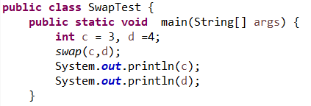


An Exploration of Parameters
Parameters aren’t quite as simple as passing values into a function. What if we want to write a swap function? Would the following function work?
The fact that it doesn’t reveals that the a and b variables we passed in aren’t the same ones being used in the function. Why not?

Slide 13
Pass-by-Value vs Pass-by-Reference
Programming languages normally take one of two approaches to passing parameters.
Pass-by-value
Allows the value of each variable to be used and modified without affecting the original variable, by creating a copy of the variable’s data
Pass-by-reference
Passes information about where in memory the variable’s data is stored, so that modifications in the function affect the original data

Slide 14
Java’s Approach
Java is pass-by-value, so primitive data types won’t retain modifications outside the function. However, for complex datatypes,
Variables normally only hold a value representing the reference to the data
Copying this reference will still point to the same data location, meaning that modified properties remain once the function exits
Modifying the reference will not affect the original reference
Original Reference
Data Structure
Copy data
Function Reference

Slide 15

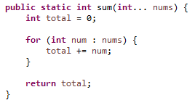
Varargs
We can pass an unspecified number of values into a function by passing an array of said values. Alternatively, we can use Java’s varargs feature.
Varargs only works on the last parameter
The last parameter is treated as an array of 0 or more elements

Slide 16
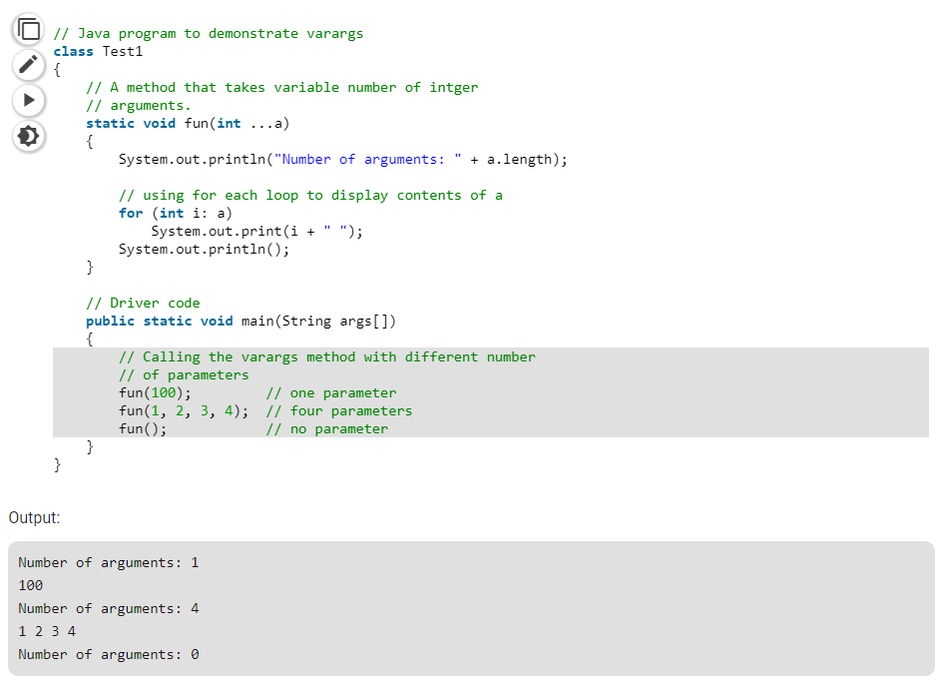
Example – Varargs
Source: https://www.geeksforgeeks.org/variable-arguments-varargs-in-java/

Slide 17

Your turn
Write a void function “reverse” that reverses an array
Write another function with the same name (in the same program) that reverses an ArrayList
Write two functions with the same name, that print all the non-negative integers below a given number, one of which starts at 0, and the other at another given number
Write a function which takes an integer, followed by an arbitrary number of other integers, and prints all values divisible by the first

Slide 18
Documentation
It can be hard to understand what a program is doing sometimes. And not just what it is doing, but why it is doing it. Imagine you're trying to read someone else's code, and you have no idea what it's doing. That doesn't sound very easy.
Now imagine you're trying to read your own code... that was written at 3am 5 months ago. That also doesn't sound very easy.
Alternatively, try to imagine code that was written at 3am last night... and now it's 4am, the day before competition. That sounds like the exact opposite of easy.
Luckily, there is a convenient solution to this. It's called documentation. Remember to always document your code. Pro-tip: always document your code.
Seriously always document code.

Slide 19

Single Line Documentation
Simple, whenever you want to explain something add //and the compiler ignores whatever happens after this point on the line.
You don’t even need a semicolon at the end of the line.
However you do need one at the end of a normal line so you would need one before the code if there was code written on the line.
Example:

Slide 20
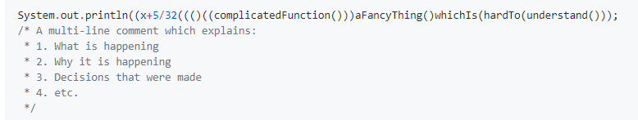
Multi-Line Documentation
You can also write more complicated documentation that goes over multiple lines. Multi-line comments start with /* and end with */. Each line that is documented should start with * (eclipse/your IDE should help with that.) For example:

Slide 21
Javadoc
Java provides some super-helpful extra documentation tools to keep things easy to understand (and use).
Javadoc helps you write useful documentation for functions(or classes), which will show a description, inputs, what it returns, and other tags (like author, errors it may throw) if desired.
The javadoc will show in the "ctrl+space" autocomplete list, and if you hover your cursor over the function name (you may need to press f2 for it to show up.) Javadoc can also be used for classes.
To create some javadoc, on the line before the function decleration, type /** (two asteriks) and hit enter. Eclipse will auto complete some useful stuff (although you can always write it manually.)
You can also use it to generate document sheets for people to read about your code. You may see this when you read documentation on java classes and functions online.
This can be helpful if you have a desire to sell code for people to use and keep the innerworkings secret or stop people from messing with it while allowing people to use it in their code. For more info on this I suggest researching online.

Slide 22
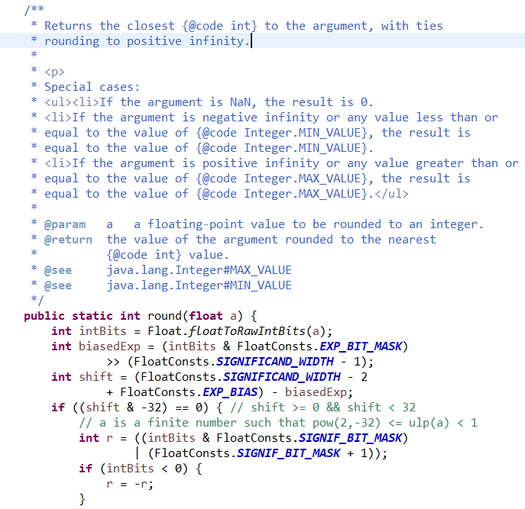
Javadoc Example:
This is documentation from a real function I took from the java API. Would you have had any idea what the code did without the documentation, or the special cases. This is why documentation is important.

Slide 23
Writing Effective Documentation
Documentation should be:
Brief and descriptive.
Explaining 'why' something was done a certain way, not how.
Explain any odd or unusual things about the code (e.g. you tried to do something x way, but it didn't work because y function is doing z odd thing, so you have to use this other odd-looking way to get it to work.)
Formal and polite (No rude words, even if you're frustrated.)
Note that variable names and function names should be descriptive.
Also Note that your code should (generally/nearly always) be simple enough to not need excessive amounts of comments. If you go online, you will find some people who try to write code so neat and simple that it doesn't 'need' comments. Other people claim the same thing, saying that it's self-documenting, even when other people can't understand it. All those people are wrong. Your code should be both simple and well-organized, and documented well. Generally I will split every couple (4-8) lines of code into blocks, which achieve/do something, and then put a short (~6 word) comment at the top saying what that block does.
Let’s look at some bad documentation.

Slide 24
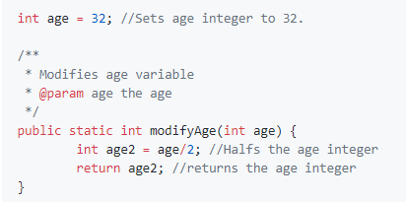
Bad Documentation 1
Not only is the documentation super-obvious and unhelpful, but it clutters the code and makes it hard to read. Function names and variable names need to be more descriptive, and the javadoc for the function is just stupid.
A good documentation would be simply in the Javadoc saying it halves the age (remember people may be selected which function they want to use from a large number and don’t have time to go trawling through all your code as well as unnecessary documentation.

Slide 25
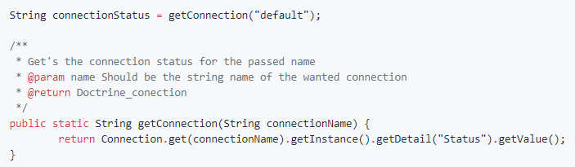
Bad Documentation 2
Here the javadoc doesn't actually tell you anything useful, rather just taking a lot of time to be confusing and over-detailed. Meanwhile the ridiculous return Connection.get(connectionName).getStatus(); line, which needs an explanation as to why it's code (and the code of Connection) is so horrifying.
Don't let those examples of bad documentation deter you though. It is always important to document, even if it's tempting not to.
Pro-tip: document.

Slide 26
Activities
8.
This isn't really something I can give an activity for... so there are none! If you want practice, feel free to go back and try documenting some of the code you wrote for previous activities. If you want some extra reading, here is a good article on documentation: https://medium.freecodecamp.com/code-comments-the-good-the-bad-and-the-ugly-be9cc65fbf83

Slide 27
Homework – add documentation to all these functions as you go
For all you python lovers, write a function which prints to the console. To call the method I would type: print(thing I want to print);
Write a function that finds the average of 4 numbers. Use the function to print out the results (NOTE: The function should NOT print out the result.)
Write a function that returns a boolean, checking if the given number is prime.
Extension: Write a function that flips a coin and returns if it lands heads as a Boolean. You should use java.util.Random to generate result. (You may need to read documentation or google it to find out how. The function should not print it but return the Boolean which you can then use to print)
Extension: Write a Java method to compute the future investment value at a given interest rate for a specified number of years. Sample data (Monthly compounded) and Output:
Input the investment amount: 1000 Input the rate of interest: 10 Input number of years: 5
Expected Output:
Years Future Value 1 1104.71, 2 1220.39, 3 1348.18, 4 1489.35, 5 1645.31

Slide 28
Lesson Summary
You should now:
What is a Function/Method and how to make one.
Parameters in java
Pass-by-value vs Pass-by-reference
Overloading
Var args
Documentation
Single Line
Multi-line
Java Doc
Next term we will start the most exciting unit of the course
OOP – which will be the main focus

